Slide 1
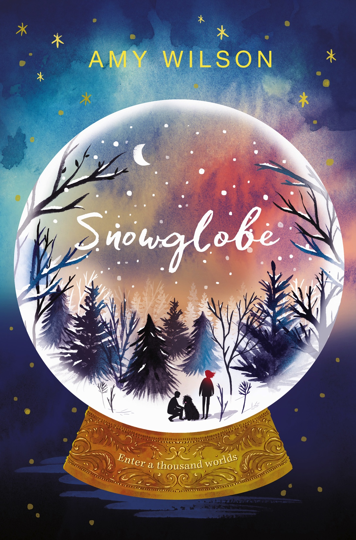
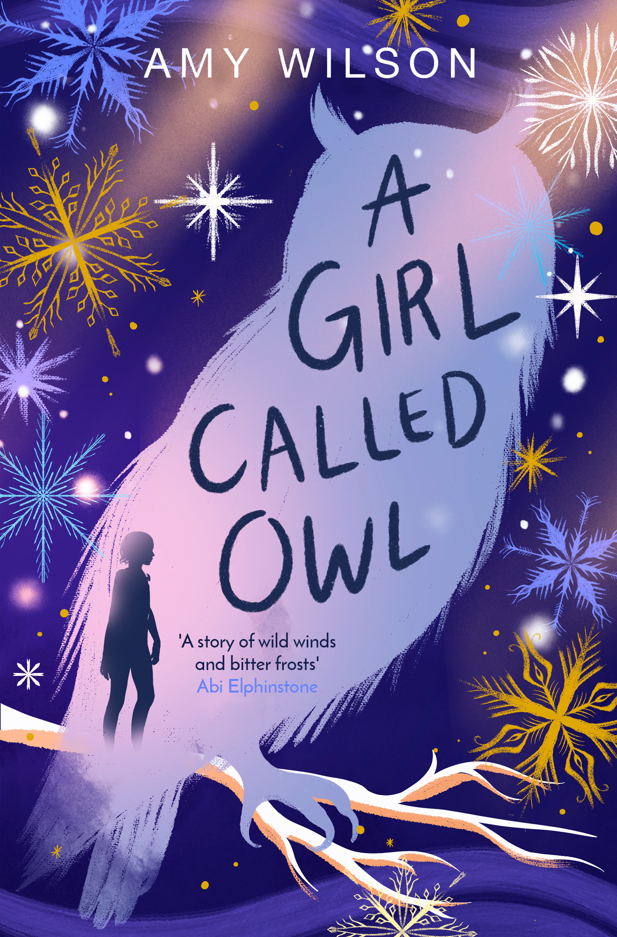
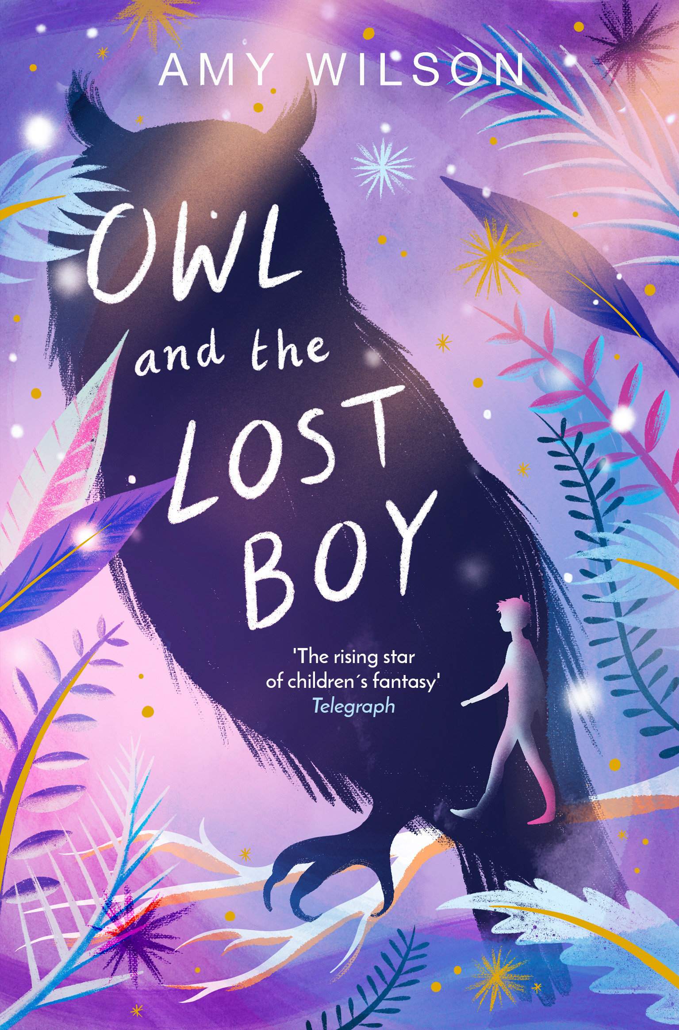
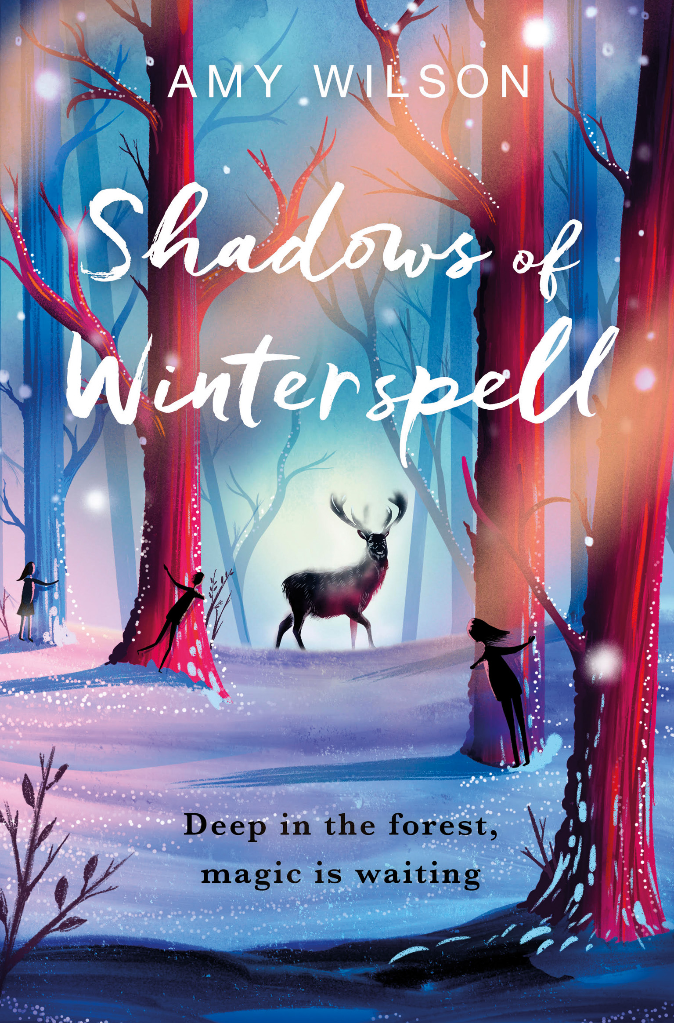
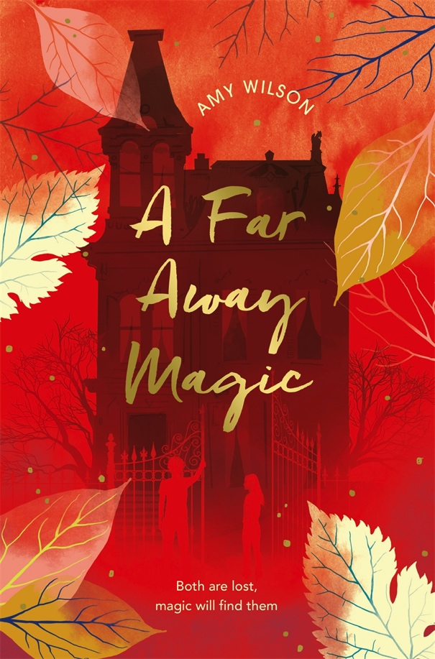
Amy Wilson

Slide 2
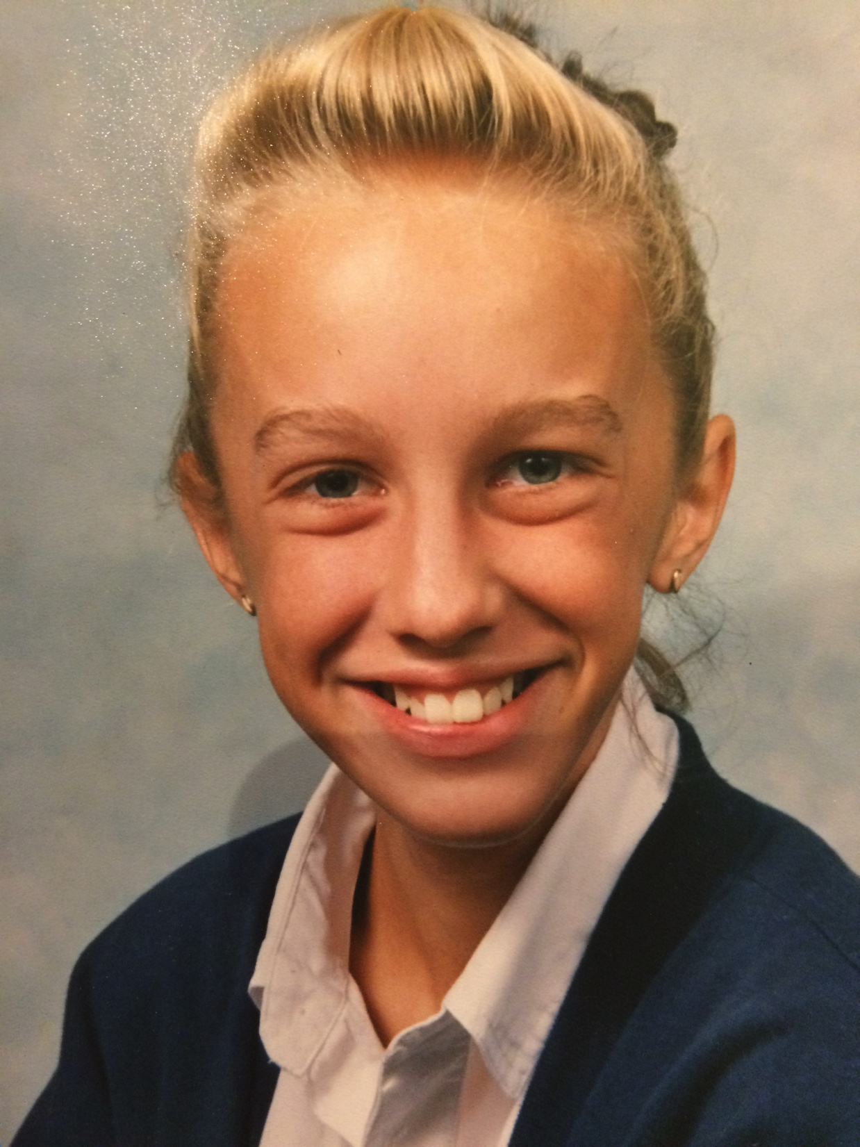
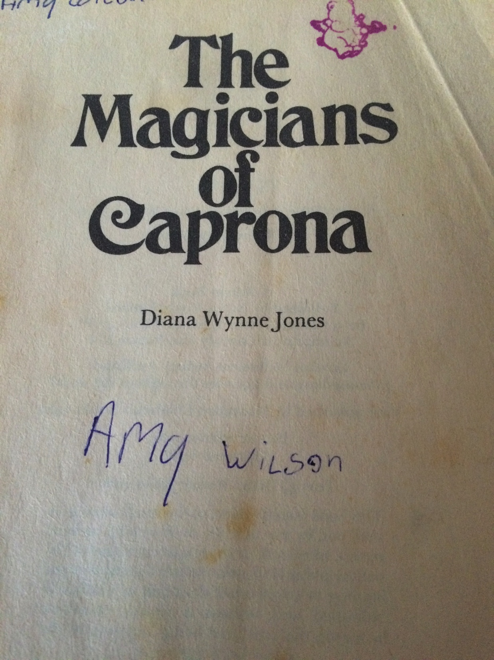
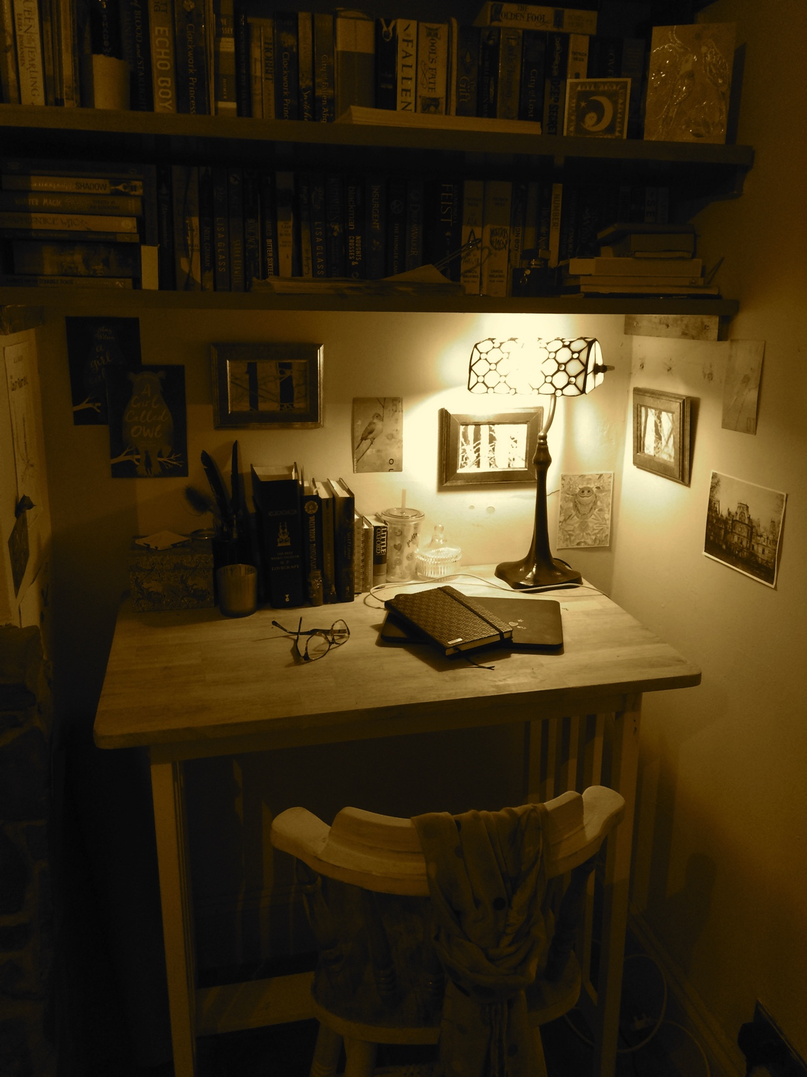
About Me
Me aged about 12! I read a lot, and wrote a lot too, though I kept the writing a bit secret. It took me a long time to finish my first novel.
Now I write at this desk, in my house in Bristol, and I have three children, and a dog. I spend my working days writing, plotting new things (terribly), reading, finding inspiration - and doing school visits.

Slide 3
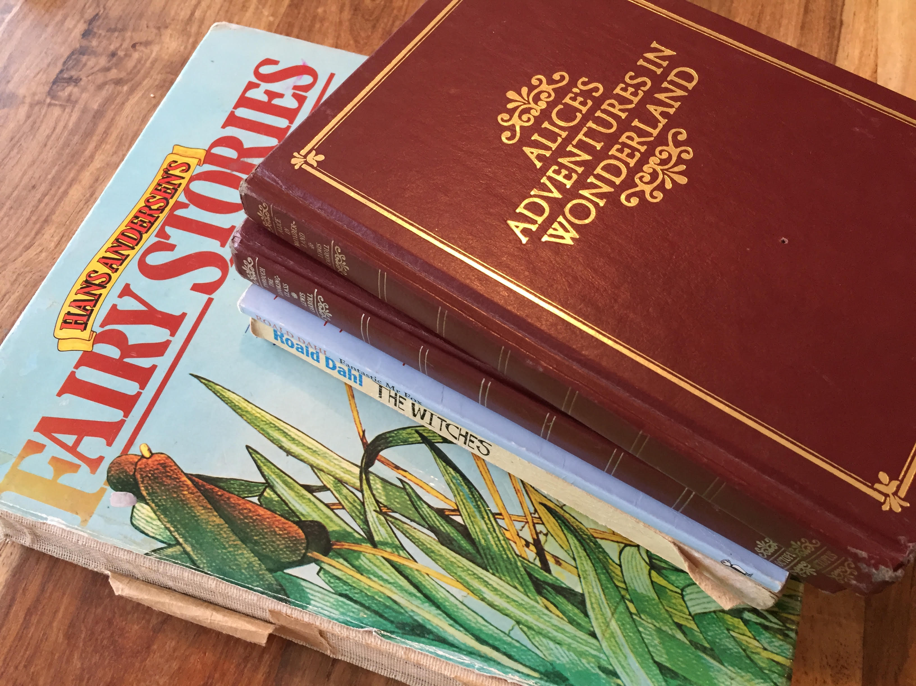
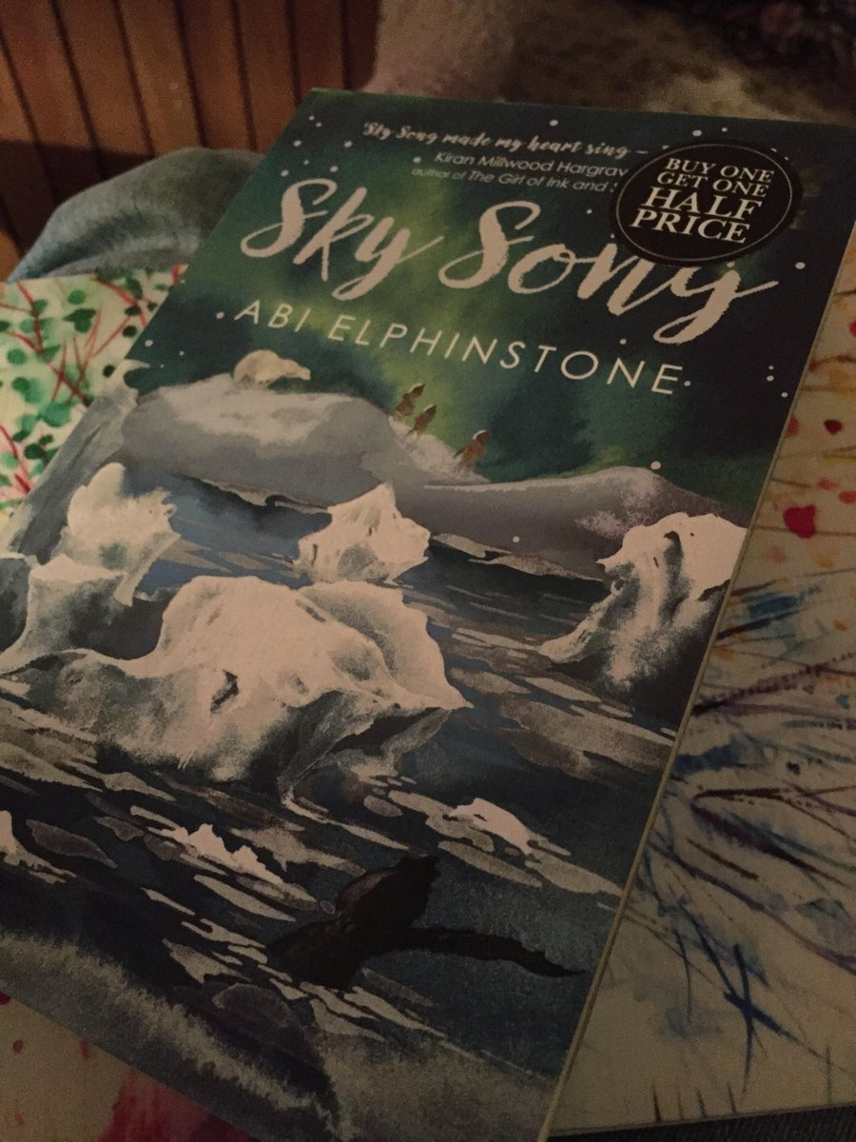
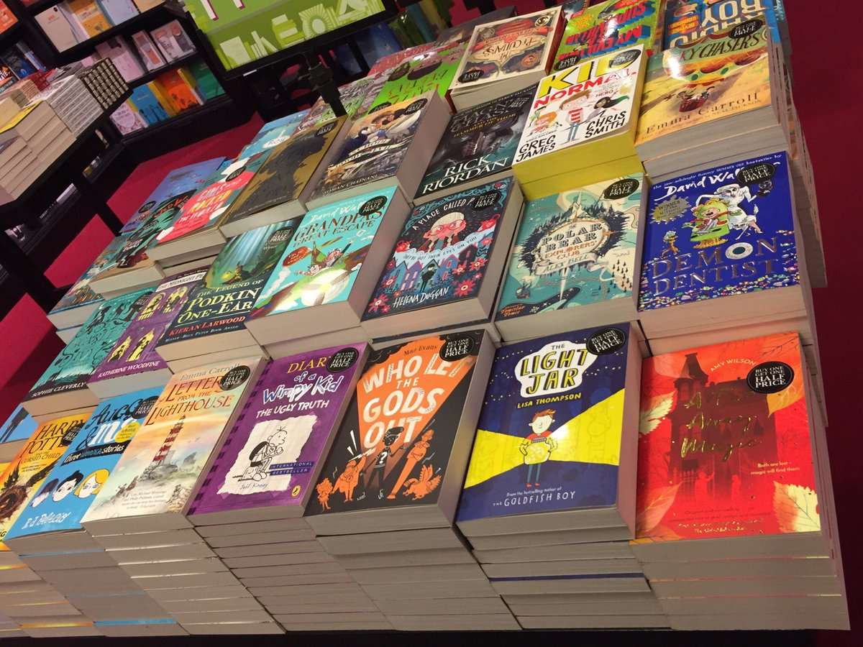
Books that inspire
Lots of writers choose to write about magic:
Those that inspired me as a child: The Hobbit, Alice in Wonderland, Diana Wynne Jones’ books, nursery rhymes and legends.
Middle grade books that inspire me today, by authors including Sophie Anderson, Abi Elphinstone, Kiran Millwood-Hargrave.

Slide 4
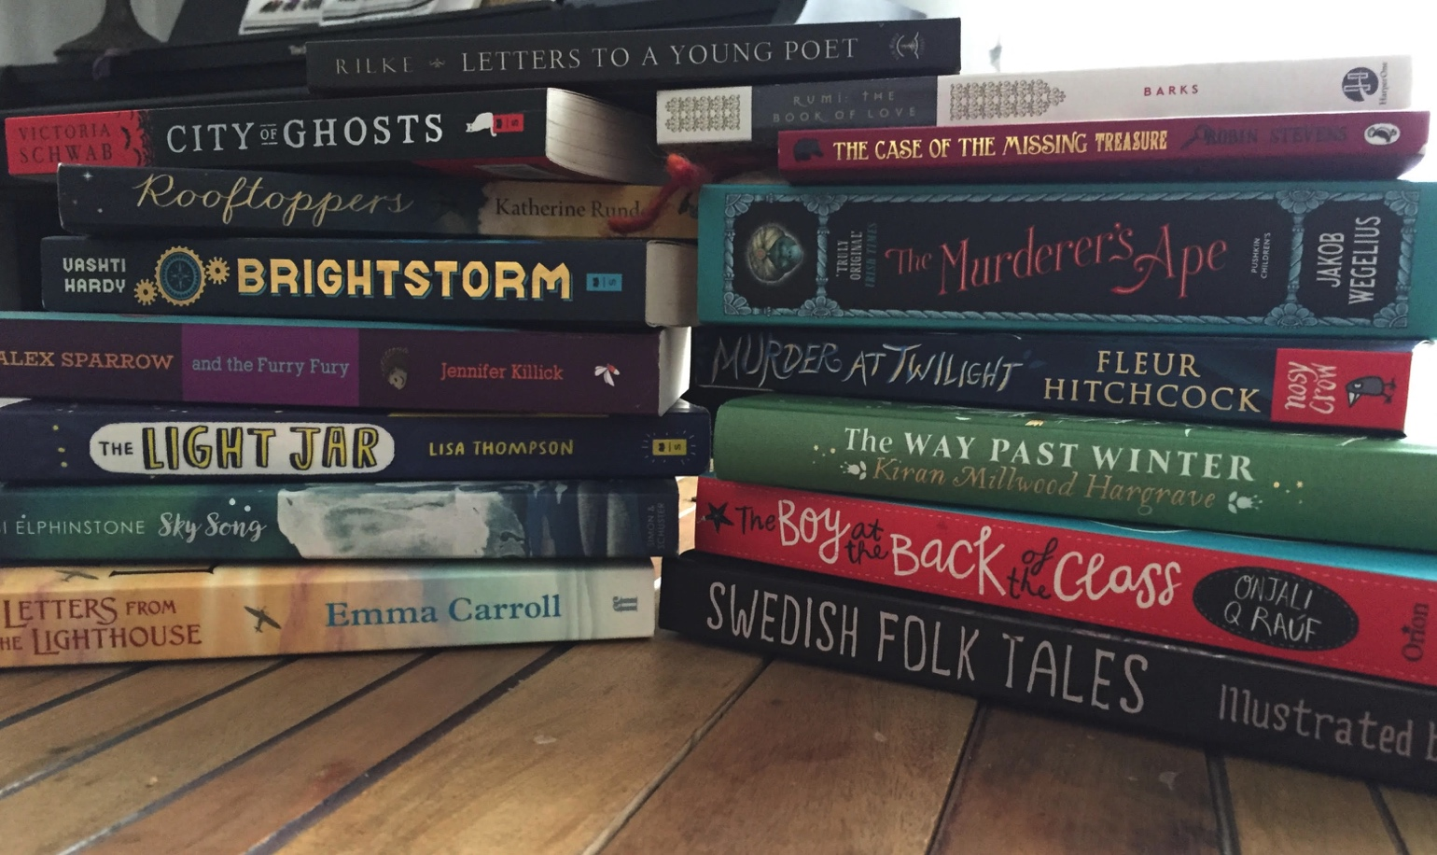
Always reading…

Slide 5
my books
- A Girl Called Owl: Owl discovers her father is Jack Frost, and she has inherited his powers.
- Owl and the Lost Boy: Owl’s autumnal friend Alberic is missing, and so is his father, the Earl of October – and without autumn winter can’t happen.
- A Far Away Magic: Bavar and Angel come together from very different backgrounds to fight the monsters his family let into the world.
- Snowglobe: Clem discovers a house full of snowglobes, in each one a trapped magician, and has to fight through worlds to rescue a friend and find her long-lost mother.
- Shadows of Winterspell: Stella is lonely, living with her ghost Nan on the edge of the shadow-cursed fae woods. She enrolls at the local school but gets much more than she bargained for there.

Slide 6
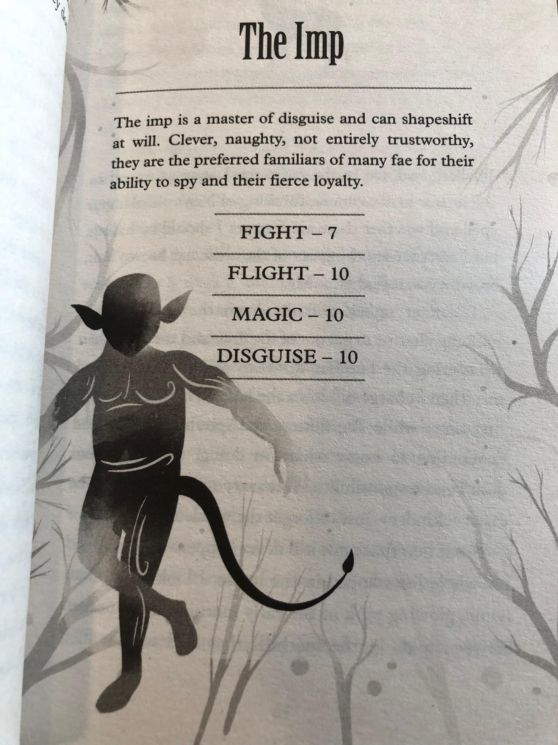
Finding a Character
Some characters come easy, as though they’ve knocked on a door in your mind
– like Owl. They say hi, and begin to tell you their story as you write.
Others – some of my favourites, like Bavar, and Clem, and Yanny – tend to hide.
They don’t want to be in the limelight, they don’t want to reveal all their secrets.
TIPS:
You can try to write your way into a story. Start with a blank page, see who comes along
You can do some background ‘research’; diary entries about them, drawings of them, details of their lives: family; friends; hopes; fears; what adventure you want for them.
(Even if you choose option one, you will still need, at some point, to do a bit of planning. But we’ll come to that!)

Slide 7
Writing magic
My characters all live in magical worlds, even if they don’t realise it at first. So that is one of my main challenges: making magic real in writing.
Imagining how it would feel
Describing that feeling, both the good bit and the bad
Being truthful in writing, a bit brave.
Using the magic of our world as inspiration.

Slide 8
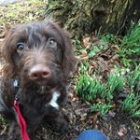
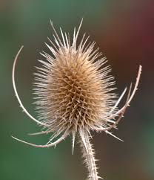
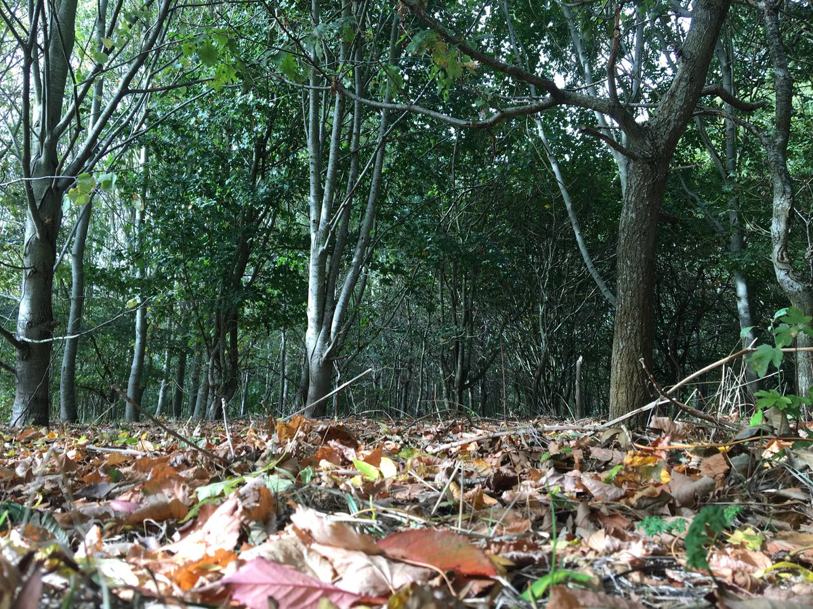
Keeping it real
Magical realism: magic integrated with the real world – the familiar with the unfamiliar. Along with magical creatures and powers, having things like school and pets, and home, to help us connect with our character. (And to show the reader what these things mean to our character… it’s always different!)

Slide 9
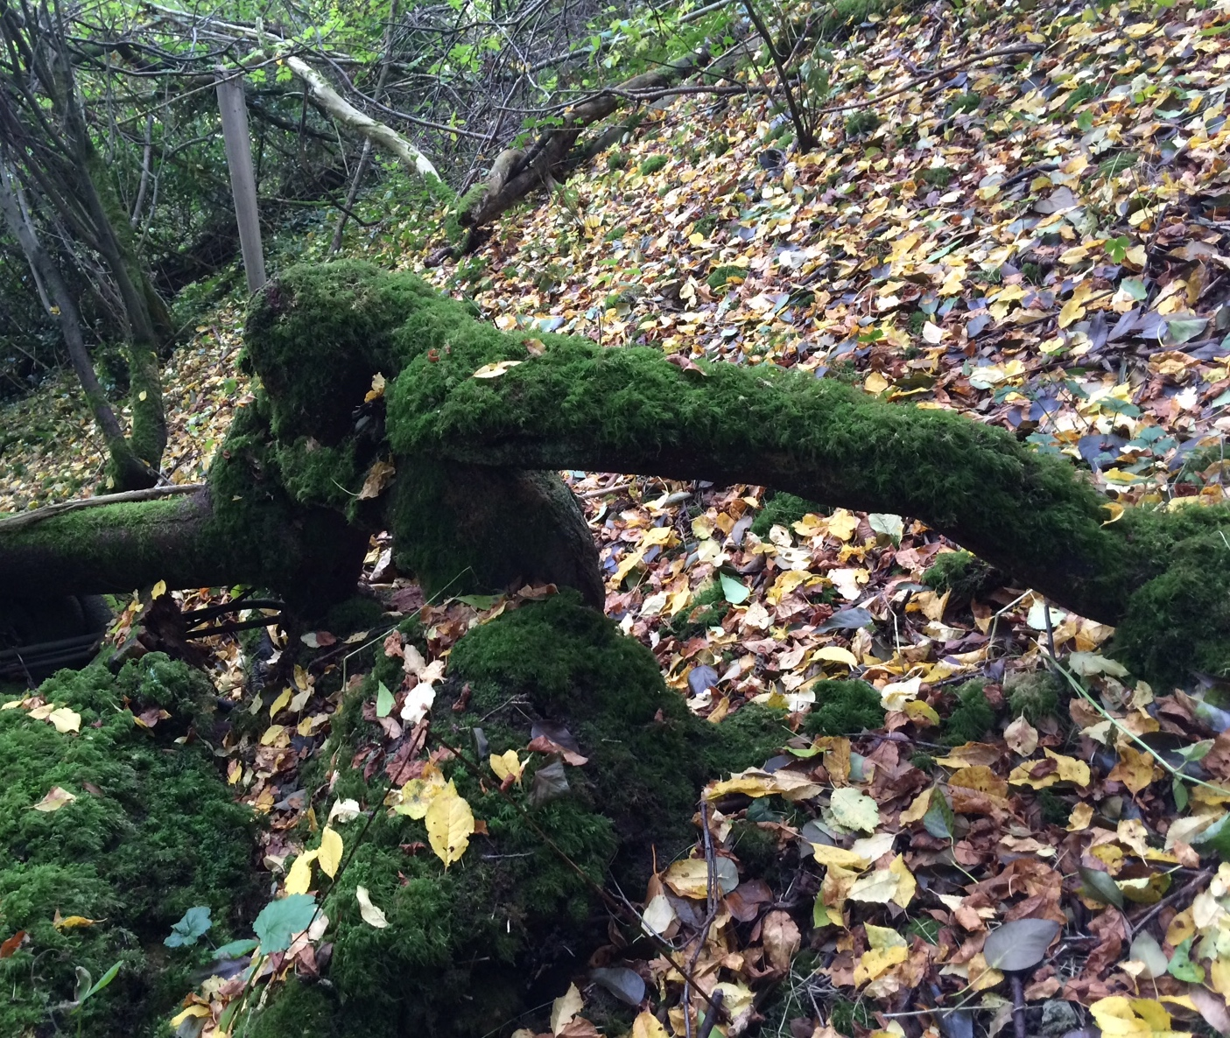
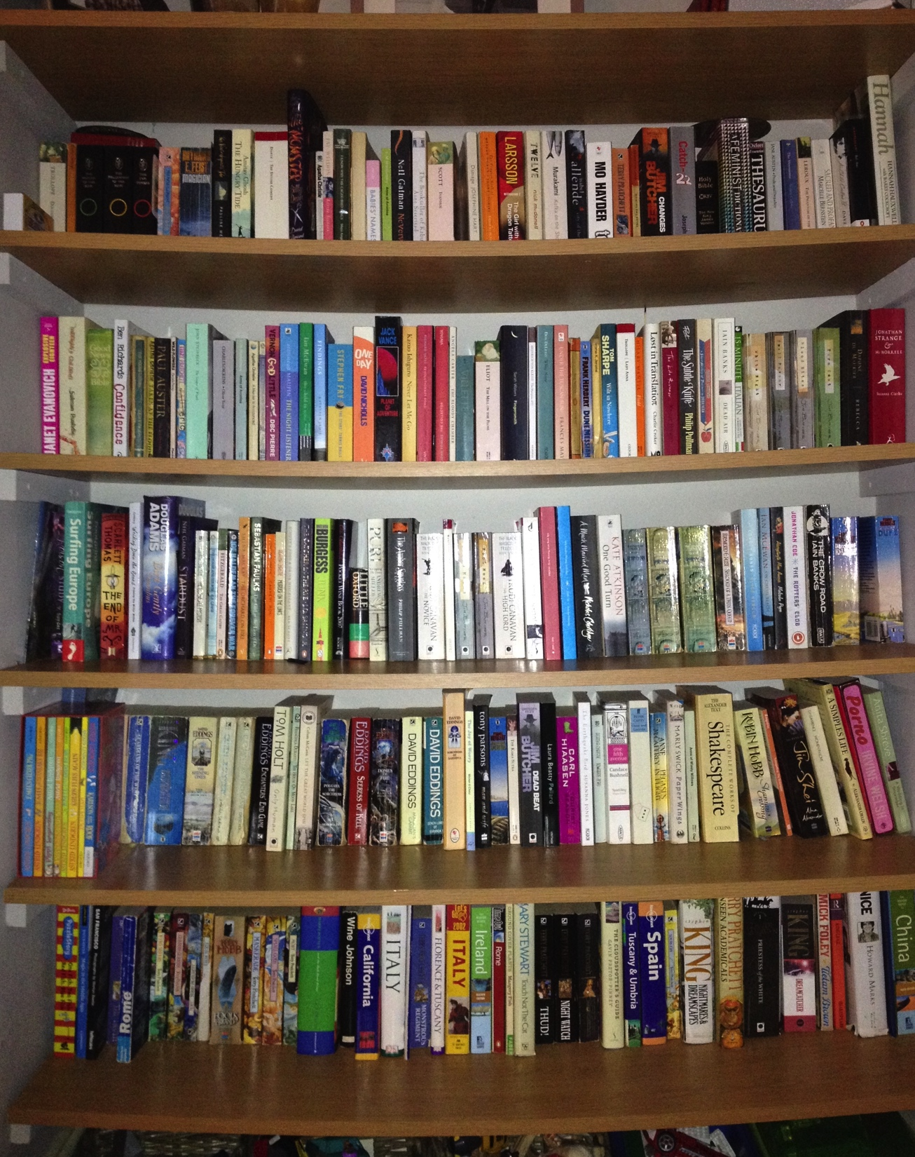
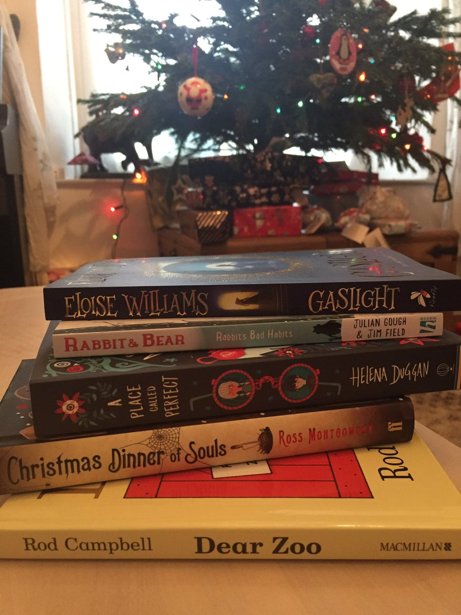
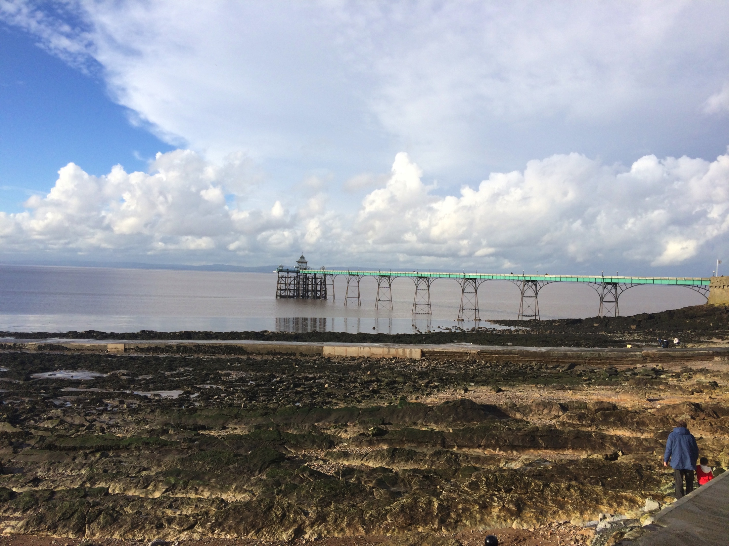
World MAGIC
Is magic real?
Deep sea monsters, mountains, sunset, snow
In us: writing, running, dancing - in our passions
In books! (Always reading…)

Slide 10
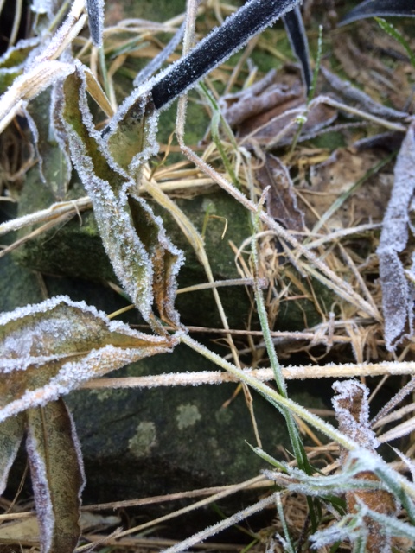
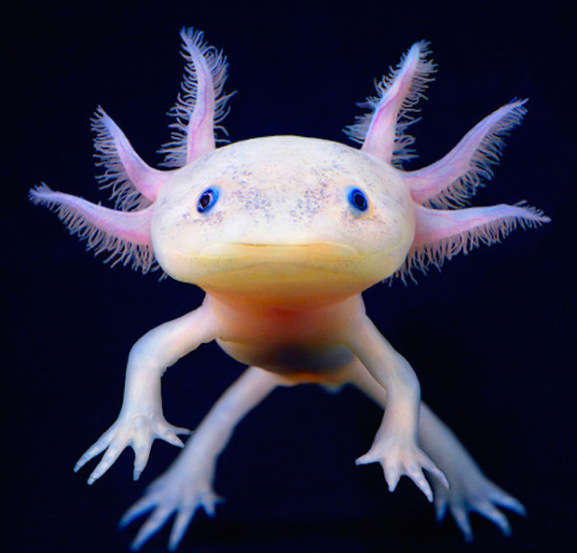
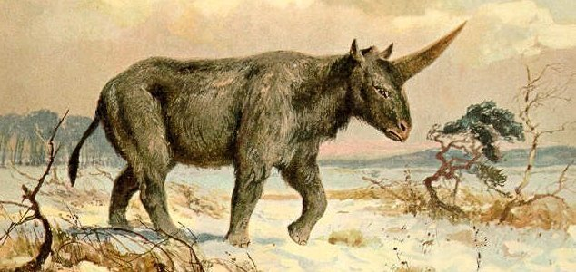
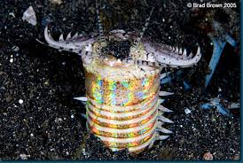
Magic in nature
Inspiration:
Seasons; autumn leaves, winter frost
Deep sea creatures; jellyfish, Axolotl: white salamander, the terrifying bobbit. (Blue Planet)
The ‘real’ unicorn was a prehistoric rhino!
Butterflies, peacocks, things we can see…
Credit: PD - Heinrich Harder

Slide 11
SUPER/fae YOU
Inspiration – imagining it’s all real and anything possible:
If you discovered you had magic, or if you were a fae character…
Who or what would you be?
What would you be able to do?
How would that change you/ your life/ your friendships?
(power/consequences)

Slide 12
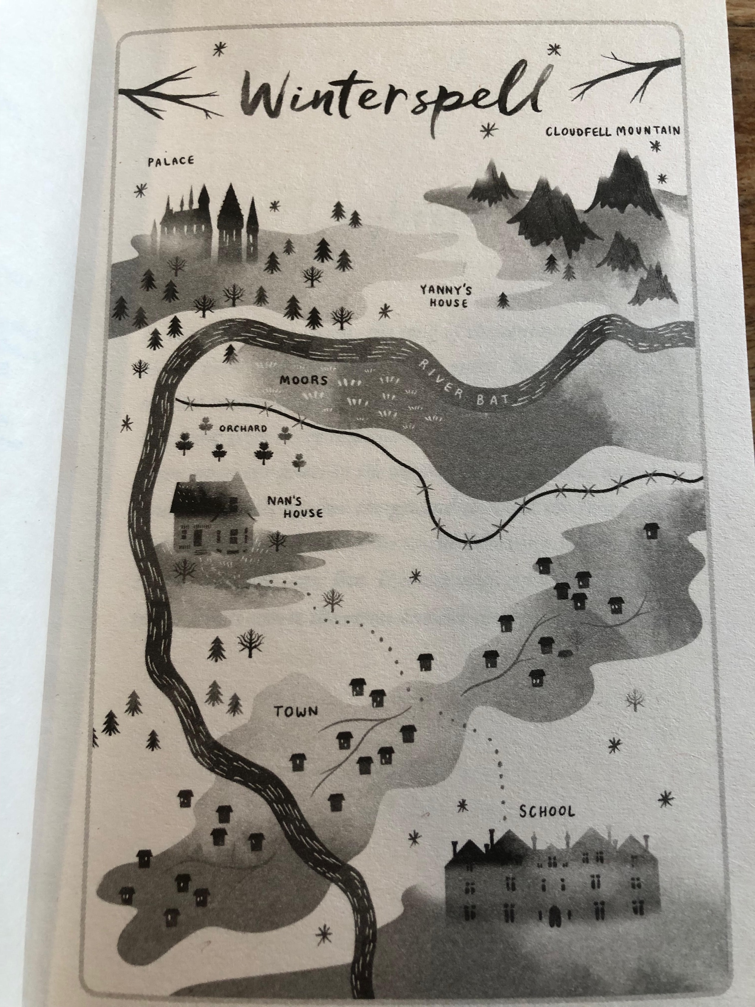
PLOTting
Are you a plotter or a do you like to make things up as you go? Most of my writing is very instinctive, and I rebel at the idea of having a plan. BUT I ALWAYS HAVE TO WRITE A PLAN!
See the plan as a map for your story. There’s a beginning, a middle and an end, and a path that leads from one to the other. Lots of things will happen on that path, whether we intend it or not. Characters do things you hadn’t expected, and so it’s really easy to get lost! If you’ve done a plan, or a synopsis, and you’ve worked out all the essentials – this bit takes me a long time - you can refer to it.

Slide 13
Your character
Who is your character? When you sit and think about a story, is there already someone knocking? Or do you need to go in search of them? For example:
What gender are they?
How old are they?
Where do they live? Who with?
What is special about them? What are their favourite/least favourite things to do?
Who are their friends? What are their friendships like? What is school like for them?
What do they need?
Homework idea: A diary entry, written in first person, to explore their hopes and wishes, and what challenges they’re facing.

Slide 14
Believing in magic
I like writing magic, I like making it feel real. I like exploring how it would change us, what the bad bits might be, what the scary bits might be.
When you write it, you have to believe in it. You have to see it, feel it, breathe it in. And get it down on the page; sometimes that’s easy, some days it’s not. (Think about where/when/time for inspiration!)

Slide 15
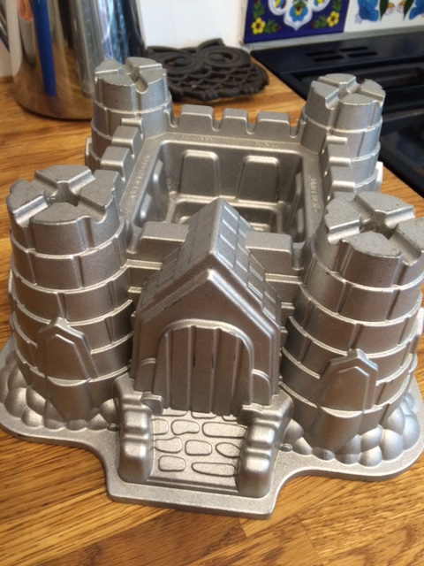
Magical editing
?

Slide 16
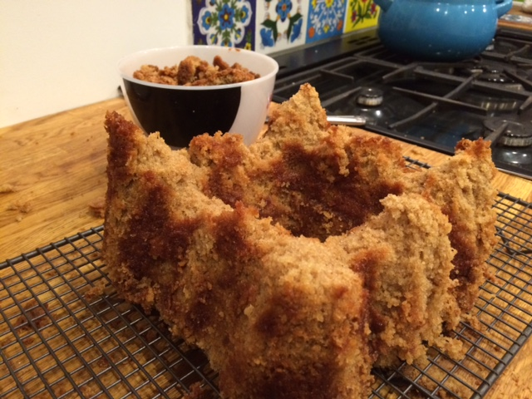
Not So Magical?
Maybe not at first…

Slide 17
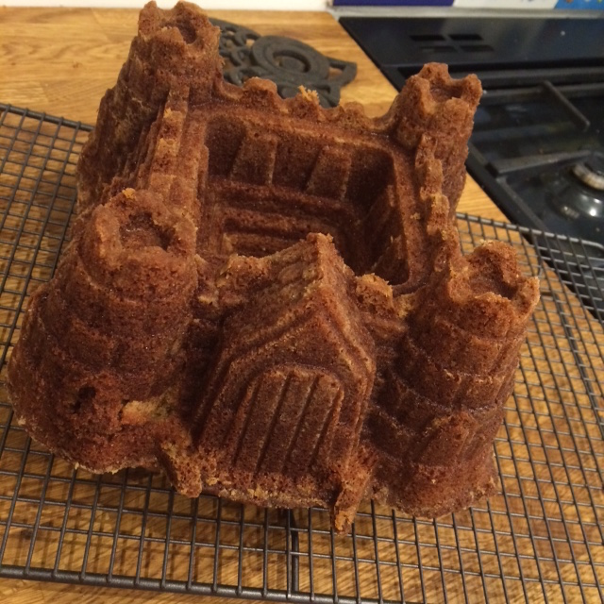
PerseRverence…

Slide 18
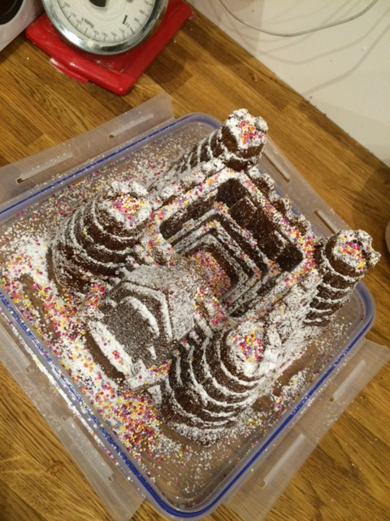
Magic in the end

